Slide 1
Programming Principles and Techniques
DATA TYPES & CONSTANTS
Notes:
1-13

Slide 2
Learning Outcomes
By the end of this session, you should be able to:
State the cell size and range for a particular data;
Differentiate three types of data;
Choose suitable data type for a variable depending on the type of value to be represented;
Identify four types of constants that exists in C language; and
Differentiate the four types of constants.
Notes:
1-13

Slide 3
Introduction
Representation of data:
  Name – character
  Age – numeric
Character is represented by char.
Numeric is represented by int, float and double.
Notes:
1-13

Slide 4
Programming Language Types
Bytes is the unit for cell sizes.
Variables are assigned cell sizes or memory spaces according to their data type.
Variables of int type are given a cell size of 2 bytes that can keep numbers up to a maximum of 32767.
Notes:
1-13

Slide 5
Programming Language Types (cont.)
Variables of float type are also assigned memory cell size of 4 bytes and can keep larger numbers up to 10³⁸ .
The size of memory cell can be doubled using the qualifier long in a variable.
Notes:
1-13

Slide 6
Programming Language Types (cont.)
  This language resembles the natural language more and it is easier to read and understand.
  It must be compiled into machine language before it can be executed. The compilation is done using compiler.
  Examples: C, C++, Ada, Lisp, Pascal, Fortran, COBOL
<number> - 13
Notes:
1-13

Slide 7
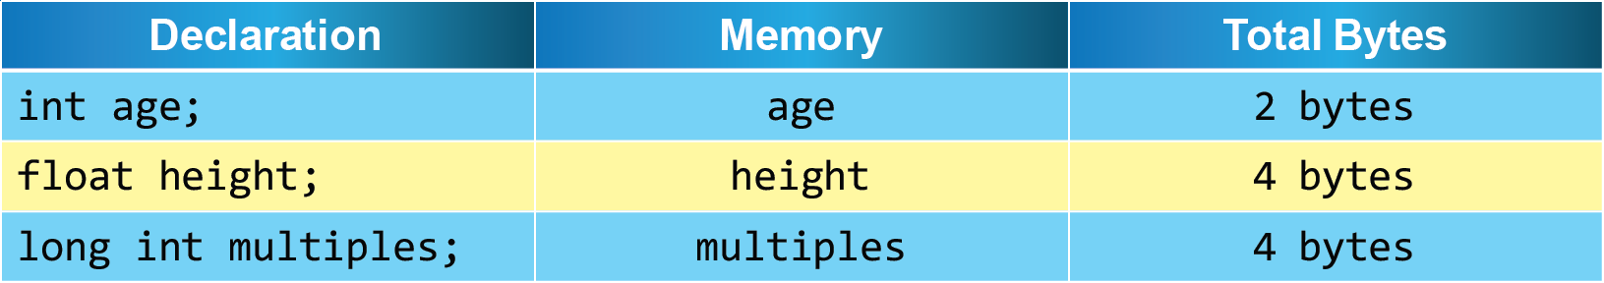
Declaration, Variables and Total Bytes
Notes:
1-13

Slide 8
Integer Data Type (int)
int data type is to represent negative or positive numbers.
Examples: -77, 0 , 999
The memory cell size for int types is depends to computer systems.
  80386 processors and below: 2 bytes
  SPARC and higher processors: 4 bytes
Notes:
1-13

Slide 9
Character Data (char)
char data type is used to represent characters like letters, digits or special symbols like ‘?’.
To assign a character to a variable, we need to put single quotes as in: ‘ ’
Example: ‘A’, ‘z’, ‘3’, ‘?’
Notes:
1-13

Slide 10
Character Data (char) (cont.)
A character can be read, printed and changed to an integer value.
We can also do character value comparisons using operators like equal (==), or not equal (!=), and relational operators like <, <=, > and >=.
Each character is represented by unique numeric ASCII codes.
Notes:
1-13

Slide 11
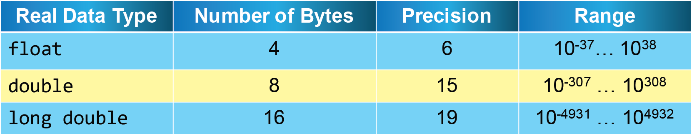
Real Data Type
Three data types for real numbers:
  float
  double
  long double
Example: 0.001, 2.0, 3.14159
Choice is made depending on the range of real values.
Notes:
1-13

Slide 12
Constants
Constants are fixed values that cannot be changed throughout the execution of the program.
Constants can be categorised into:
  Integer constant
  Real constant
  Character constant
  String constant
Notes:
1-13

Slide 13
Integer Constant
Integer constant refers to an integer number that is fixed.
There are a few types of integer constants based on decimal, octal and hexadecimal numbers.
Example:
Decimal | 0 | 2 | 99
Octal | 0 | 07 | 074
Hexadecimal | 0X | 0X1 | 0X7A
Notes:
1-13

Slide 14
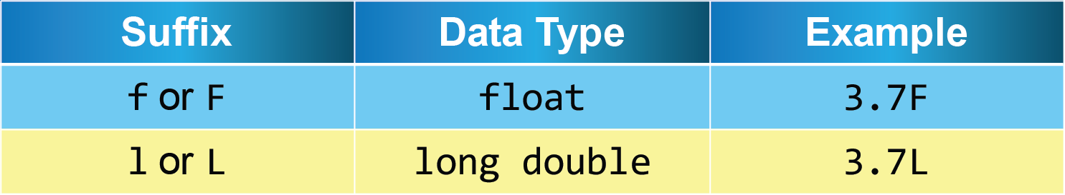
Real Constant
Real constants take their value just like real values in the number system.
Floating point notation or exponent notation, or both can represent real constants.
A suffix is added to the floating point constant to specifically state the type.
Notes:
1-13

Slide 15
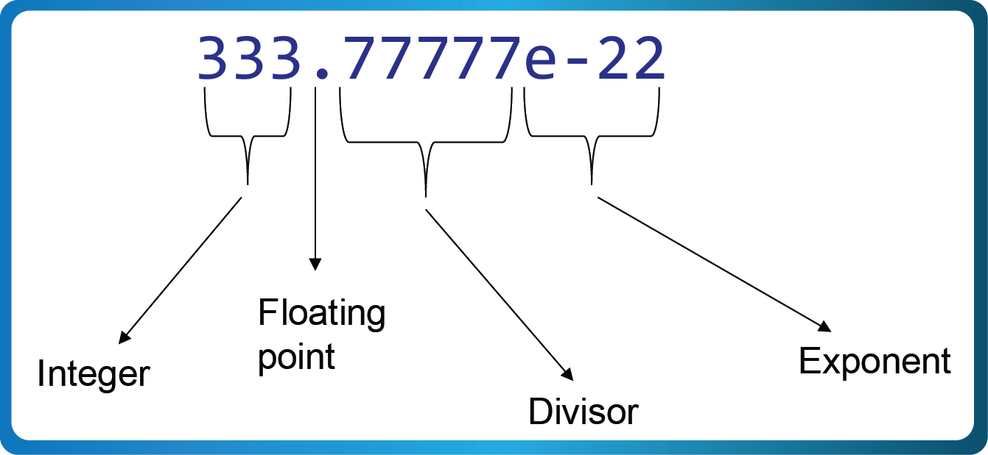
Real Constants
Exponent notation for real constants can be written as 1.234567e5.
This is equal with the scientific notation 1.234567 x 105.
A floating point constant number consists of 4 parts:
Notes:
1-13

Slide 16
Character Constant
Character constants must be surrounded by single quote.
Example: ‘A’, ‘z’, ‘?’, ‘5’
Character constants have certain integer values that is determined by character code or coding system used by a computer.
Most computers use ASCII code to represent its characters.
Example: Character ‘A’ is valued 65 in ASCII
Notes:
1-13

Slide 17
String Constant
String constants are made up of some characters surrounded by double quotes.
Example: “UNITAR”, “Information Technology”, “X”, “ ”, “1, Jln TTS 4/6”, “123”
Any strings in between double quotes are a character array.
Notes:
1-13

Slide 18
String Constant (cont.)
Each string constant will have a null character (written as ‘\0’) automatically by C compiler as an end of the character array.
Example: “UNITAR” is actually “UNITAR\0”
Remember: “A” is not equal with ‘A’
Notes:
1-13

Slide 19
Summary
int data type is to represent negative or positive numbers.
char data type is used to represent characters like letters, digits or special symbols.
Three types of real data types: float, double and long double
Notes:
1-13

Slide 20
Summary (cont.)
Integer constant refers to a value (integer) that is fixed.
Real constants take their value just like real values.
Character constant must be surrounded by single quote.
String constants are made up of some characters surrounded by double quotes.
Notes:
1-13

